Slide 1
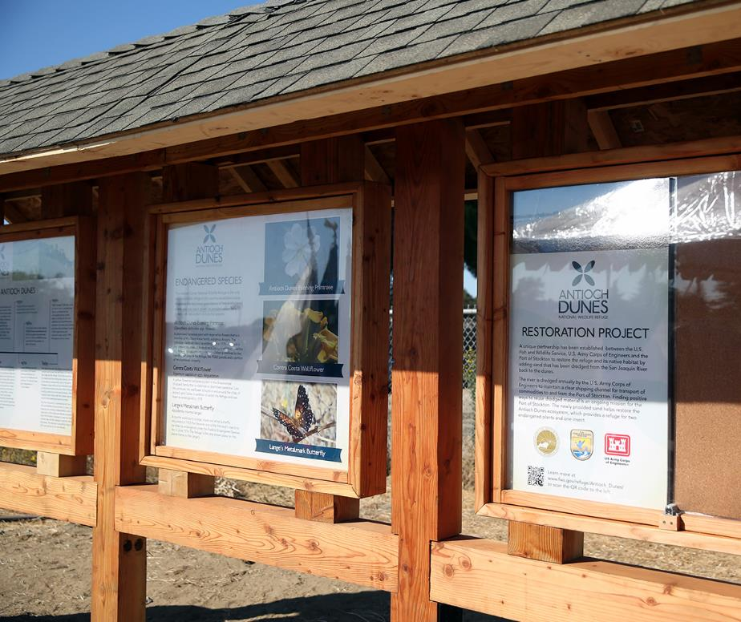
Port of Stockton
Restoration Project Dedication Ceremony
Use this area for image(s) placement.
Delete this text box before placing image(s).
Please limit image file size to more than 1 MB.
Special Event
Use this area for logo
(delete text box before placing logo)

